Slide 1
Digital Portfolio
STUDENT NAME: Rahul Raj R
REGISTER NO AND NMID: BF2F70BBA48F34EBB294337CD7C76F1A
DEPARTMENT: Bsc . COMPUTER SCIENCE
COLLEGE: COLLEGE/ UNIVERSITY APOLLO ARTS AND SCIENCE/ UNIVERSITY OF MADRAS

Slide 2
PROJECT TITLE
STUDENT PORTFOLIO

Slide 3


AGENDA
Problem Statement
Project Overview
End Users
Tools and Technologies
Portfolio design and Layout
Features and Functionality
Results and Screenshots
Conclusion
Github Link
3/21/2024 Annual Review

Slide 4

PROBLEM STATEMENT
Students often struggle to effectively showcase their skills and projects beyond a traditional resume or academic transcript. This makes it difficult for them to stand out to potential employers, universities, or collaborators, leading to missed opportunities for internships, jobs, and further studies. A digital portfolio is a necessary solution to this problem, providing a structured, interactive, and accessible platform to present their achievements and experiences in a comprehensive way.

Slide 5

PROJECT OVERVIEW
This project aims to create a digital portfolio that serves as a single, organized platform to showcase personal achievements, skills, and projects. The main idea is to build an online presence that goes beyond a traditional resume, offering a comprehensive and interactive view of my work. The portfolio will be divided into four key sections: "About Me," "Projects," "Skills," and "Contact," each designed to highlight different aspects of my professional identity and provide a clear, user-friendly experience for anyone who visits the site.

Slide 6

WHO ARE THE END USERS?
*Students: To display academic projects and supplement their resumes.
* Job seekers: To share with recruiters and hiring managers.
* Freelancers: To show clients examples of their work.
* Professionals: To highlight their experience and achievements for career advancement.

Slide 7

TOOLS AND TECHNIQUES
HTML: Used for the structure of the website, including all the pages and sections.
* CSS: Employed for styling the website, such as colors, layouts, and ensuring responsiveness.
* JavaScript: Utilized to add interactivity, including smooth navigation menus, animations, and form validation.

Slide 8
POTFOLIO DESIGN AND LAYOUT
*Design Philosophy: It will adopt a clean, minimalist aesthetic to keep the focus on the projects and skills being showcased.
* Responsiveness: A mobile-first approach will be used to ensure the design adjusts seamlessly to different screen sizes, providing an optimal viewing experience on desktops, tablets, and smartphones.
8

Slide 9
FEATURES AND FUNCTIONALITY
*Navigation Bar: A navigation bar that enables smooth scrolling to different sections of the website.
* Project Showcase: A dedicated area to display projects with images and details for each one.
* Interactive Elements: The use of features like hover effects and animations to make the site more engaging.
* Contact Form: A form for visitors to send messages, which includes validation to ensure correct input.

Slide 10
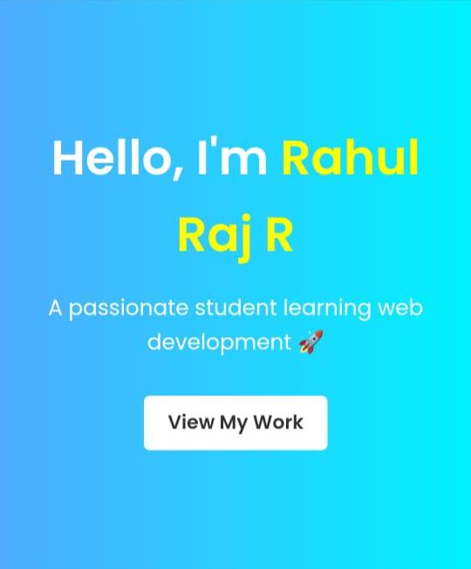

RESULTS AND SCREENSHOTS
3/21/2024 Annual Review
10

Slide 11
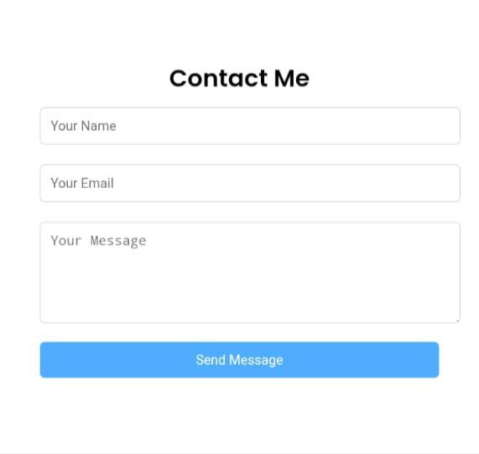
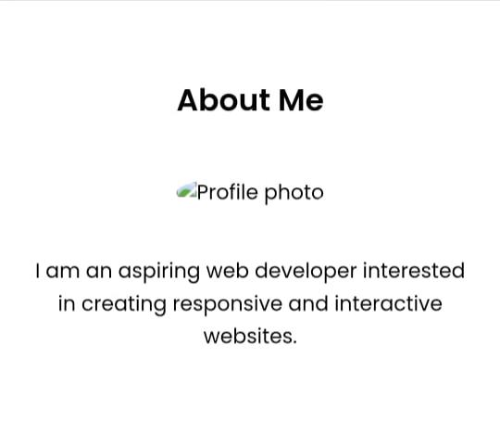
RESULT AND SCREENSHOTS

Slide 12
CONCLUSION
The creation of this digital portfolio is a comprehensive and strategic project designed to solve the common problem of showcasing skills and achievements in a dynamic and accessible way. By building an interactive online platform, this project will serve as an essential tool for a wide range of users, from students and job seekers to freelancers and seasoned professionals.The project's structure, which includes a clear problem statement, defined end-users, a well-planned technical stack (HTML, CSS, and JavaScript), and a focus on both minimalist design and core functionality, ensures a successful outcome.
12

